Slide 1
Building Office Add-ins for Microsoft Excel
Working with Dialogs

Slide 2

Working with Dialogs
Dialog overview
Opening dialogs
Dialog input/output
Demo
Notes:
In this unit, you'll learn how to incorporate dialogs in Excel workbooks. You'll learn how to open dialogs and how to submit and retrieve inputs and outputs for the dialog.

Slide 3
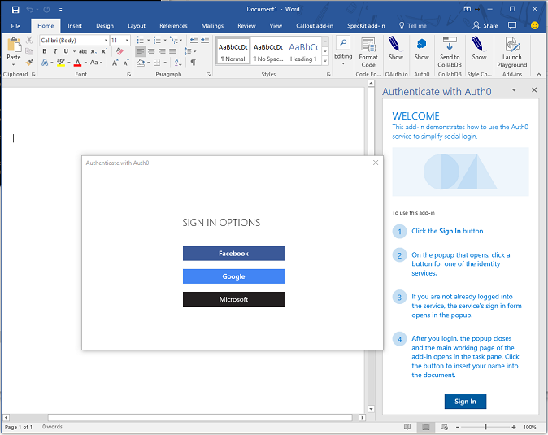
Dialogs
The Dialog API enables a dialog box to be opened from an Office Add-in and is an extension of the UX you can customize in Office.
A primary scenario for the Dialog API is to enable authentication with 3rd party providers, where app domains might not be predictable or displayable in a frame.
The Dialog API can provide additional screen real estate for elements difficult to view in a traditional task pane or content Add-in.
The Dialog API must be launched with a known app domain, but can immediately go to any website (or other resource) that uses HTTPS.
Notes:
The Dialog API is and extension of the user experience you can customize in Office. You can use it to open dialogs from your add-in that interact with the user and your main add-in UX.
The primary scenario for the dialog API is authentication with 3rd party providers. Most identity providers prevent their sign-in experiences from being displayed in an iframe due to click-jacking concerns. This is troublesome with an add-in as they are displayed in iframes in some of the clients such as Office Online. Another challenge with authentication scenarios is predicting the domains that will need to load. In federated sign-in scenarios the potential list of domains could be endless, which again is troublesome in an add-in where all domains need to be registered in the manifest.
It is important to note that Office offers a single sign-on experience specific for Microsoft identities. So if you add-in requires data about the Office user or their resources accessible through Microsoft Graph, such as Office 365 or OneDrive, we recommend that you use the single sign-on API whenever you can. If you use the APIs for single sign-on, then you will not need the Dialog API.
Beyond authentication, the dialog API can provide additional screen real estate for elements difficult to display in a traditional task pane of content add-in. A good example would be hosting a video that would be too small if confined to a task pane
As suggested when I mentioned federated scenarios…the dialog API can display ANY https webpage, but you must launch it to an app domain first and then redirect.

Slide 4
Opening dialogs
Office.context.ui.displayDialogAsync("<URL />", options, optionalCallback);
URL
The dialog should initially open to a page hosted from an app domain (as defined in manifest).
The dialog can display any page that is hosted securely (HTTPS).
Options
Display options include dialog height and width (in % of device screen), which by default are 80% of the height and width of the device screen.
A displayInIframe option can be set to display as a floating iframe rather than an independent window (in clients that support this), which makes it open faster.
Optional Callback
The optional callback allows a host page (the page that opens the dialog) to listen for messages from dialog.
Notes:
Open a dialog using the `diaplayDialogAsync()` method from an Office add-in:
The `displayDialogAsync()` method accepts three parameters:
- The `<URL />` is the page to be displayed in the dialog. It most initially be a page hosted from an app domain as defined in the manifest. However, the page can immediately redirect to a different page.
- The `options` parameter allows the developer the modify the size of the dialog. By default, the dialog will display as 80% of the height and width of the device screen. The values for height and width are expressed as percentage of the device screen.
Developers can optionally set the `displayInIframe` property in the options. Setting this to `true` will cause the dialog to display as a floating Iframe rather than an independent window (in clients that support this), which makes it open faster.
- The `optionalCallback` allows the add-in's host page to respond to messages and events from the dialog.

Slide 5
Dialog input/output
/******* Start Host page script *******/
// Open the dialog passing the parameter id=123 let dialog = null; Office.context.ui.displayDialogAsync('https://domain/popup.html?id=123’, {height: 45, width: 55}, function(result) { dialog = result.value; // Listen for messages coming from the dialog dialog.addEventHandler( Microsoft.Office.WebExtension.EventType.DialogMessageReceived, processMessage); });
function processMessage(arg) { // Log the message send from the dialog and close the dialog console.log(arg.message); dialog.close(); } /******* End Host page script *******/
/******* Start Dialog page script *******/ // Dialog must call Office.initialize Office.initialize = function() { // Send the parent/host a message Office.context.ui.messageParent(‘Hello from the dialog!!!‘); } /******* Start Dialog page script *******/
Points of interest
The primary way to pass information to a dialog is through local storage (ex: window.localStorage) or URL parameters in the dialog URL.
A dialog can pass messages back to the host by calling Office.context.ui.messageParent and sending either a Boolean or string value to the host page.
The messageParent function can only be called on a page with the same domain (including protocol and port) as the host page.
The host page must “listen” for messages by subscribing to the DialogMessageReceived handler.
Notes:
The primary way to pass information to a dialog is through the browser's local storage (`window.localStorage`) or through URL parameters in the dialog URL. In this sample, the host page is passing an id of "123" to the dialog via a url parameter.
A dialog can pass messages back to the host by calling `Office.context.ui.messageParent` to send either a Boolean value or a string message to the host page. At the bottom of the sample you can see the dialog script where it is passing the message "Hello from the dialog!!!" to the parent.
The `messageParent()` method can only be called on a page with the same domain (including protocol and port) as the host page.
The host page must listen for messages by subscribing to the `DialogMessageReceived` handler. In the sample, the host page registers this handler using the `processMessage` function, where it logs the message to the console.

Slide 6
Demo
Notes:
In this demo, we will look at an add-in for Microsoft Excel that leverages the dialog API
Open the completed solution located in the Demos/04 All Complete folder
Run npm install
Run npm run build
Run npm start
Side-load the add-in
Launch the add-in using the Show Taskpane button in the ribbon
Click on the Open Dialog button to launch the dialog
In the dialog, enter your name and then click the Ok button
Point out how the dialog closes, but not before messaging the host page your name.

Slide 7

Summary
The Dialog API provides a flexible extension to the Add-in user experience.
Dialogs can enable 3rd party authentication scenarios and scenarios where additional screen space is required.
Information can easily be pass to and from the Dialog API.

Slide 8
Reading further
Excel Add-ins overview
https://docs.microsoft.com/en-us/office/dev/add-ins/excel/excel-add-ins-overview
Excel JavaScript API reference
https://docs.microsoft.com/en-us/javascript/api/excel?view=excel-js-preview
Dialog API sample
https://github.com/OfficeDev/Office-Add-in-Dialog-API-Simple-Example
Use the Dialog API in your Office Add-in
https://docs.microsoft.com/en-us/office/dev/add-ins/develop/dialog-api-in-office-add-ins

Slide 9
Thank you

